Slide 1
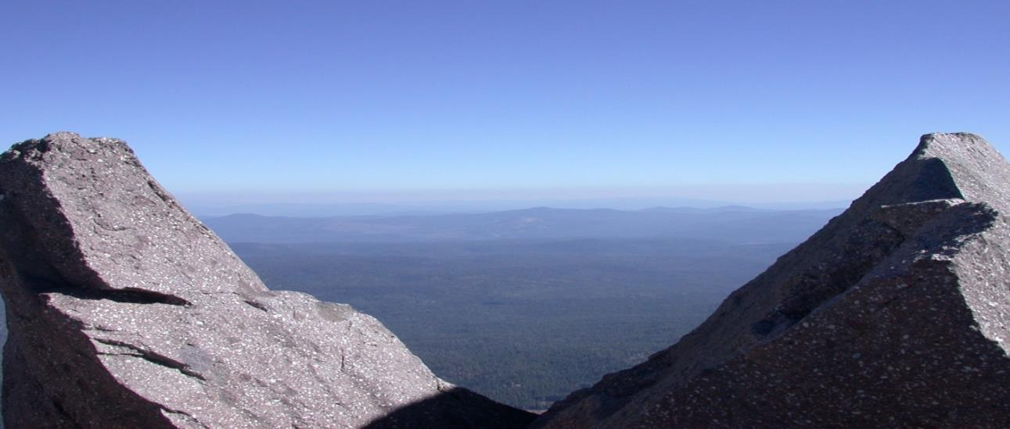
How to be a Success
(in Dentistry)
Michael W. Lew, BA, DMD, FICOI, FPFA, FACD, FICD, MAGD
Notes:
I am Michael Lew. Look at all of the lettering behind the name- does that mean I’m a success in dentistry? In dental school I thought that is what success meant.

Slide 2
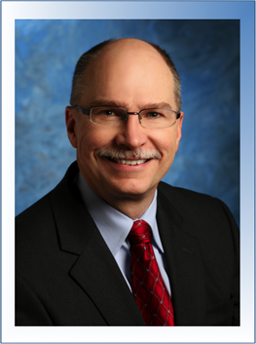
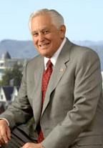
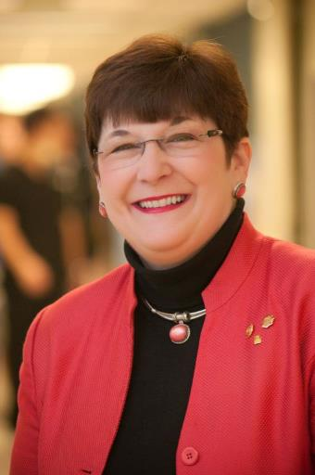
Dr. Latta
Dr. Dugoni
Dr. White
Notes:
These are successful dentists- These are our teachers in our dental schools

Slide 3
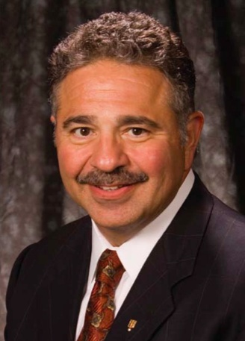
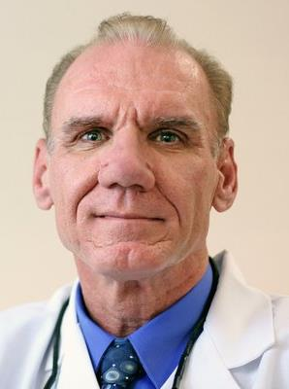
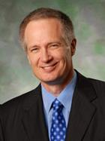
Dr. Kois
Dr. Albers
Dr. Misch
Notes:
These are successful dentists- These are our teachers in after dental school.
The AGD is about improving our skills and services through continuing education after dental school.
These dentists have trained hundreds to be the best they could be.

Slide 4
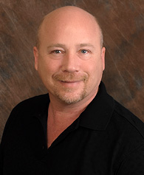
Howard Farran, DDS MBA is a noted international lecturer on faster, easier, more efficient dentistry.
In his seminar entitled, “The Virtues of Profitable Dentistry” he gets down to the nitty gritty details of running a thriving family practice. He can show any dental team how they too can achieve their dreams and goals.
Dr. Farran graduated from UMKC dental school in 1987.
Dr. Farran is the founder and publisher of Dentaltown Magazine, which is mailed to more than 120,000 dentists in 43 countries each month. Dr. Farran is also the founder Dentaltown.com.
Notes:
Dr. Farran is a successful dentist and businessman and educator

Slide 5
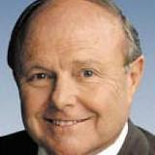
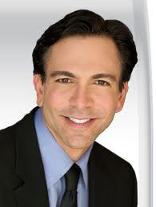
Den Mat
Discus Dental
Notes:
These two dentists are success businessmen

Slide 6
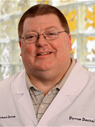
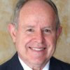
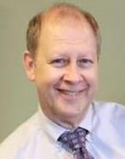

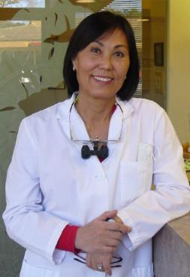
Notes:
These guys are successful dentists

Slide 7
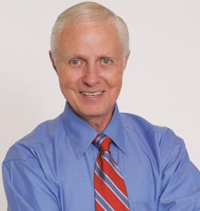
Dr. Gordon Christenson

Slide 8
Why are you here?
Be a successful dentist
Find a Job
Have some Money
Have Prestige ?

Slide 9
How to be a Success
(in Dentistry)
Begin with the End in Mind
Work Diligently
Keep your Integrity
Habits
Don’t Do it Alone

Slide 10
How to be a Success
(in Dentistry)
Begin with the End in Mind
Work Diligently
Keep Your Integrity
Habits
Don’t Do it Alone

Slide 11

Is he a success?

Slide 12
Begin with the End in Mind
“If you board the wrong train, it is no use running along the corridor in the other direction.”
–Dietrich Bonhoeffer

Slide 13
Begin with the End in Mind
Think what you wanted when you were 16.
Who did you dream of becoming?
Notes:
These dreams reflect your emotions- your desires may stay with you for life. Your emotional desires will power what your logic decides to do.

Slide 14
Begin with the End in Mind
Imagine yourself as 66.
You are looking back—what have you accomplished?
Notes:
These will be what you have done, what you can put on your headstone

Slide 15
Why do you really want to practice dentistry?
What is your definition of success?
Notes:
Audience interacton

Slide 16
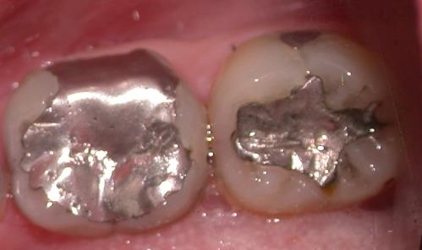
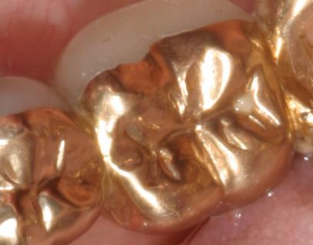
What is your definition of success?
Notes:
Compare the two restorations
Both are around twenty years old
Dr. Lew’s work

Slide 17
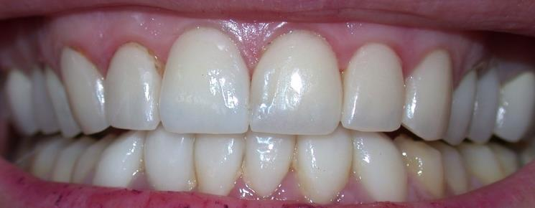
Do you want to be the artist, the finest dentist in your community?
Notes:
There is always someone better
There is always something not good enough

Slide 18
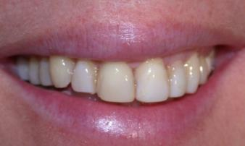
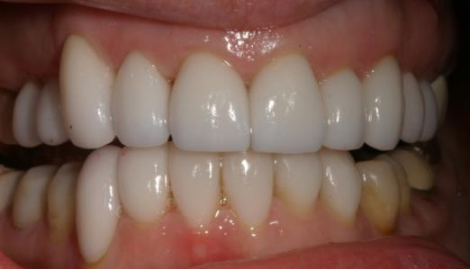
The Small Office
  Dentistry-oriented
  One dentist; one to two dental staff
  Low overhead
  Lower revenue
  High profit margins
  control
Notes:
This may be one pathway to great success
No insurance!

Slide 19
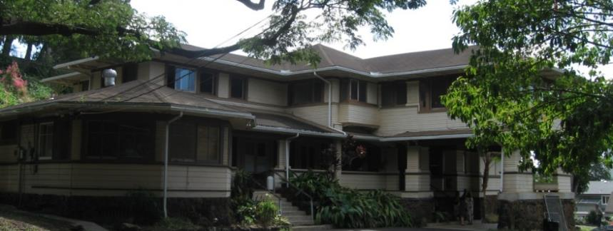

Do you want to be wealthy?
Notes:
Being a great dentist and wealthy are not exclusive
But they are two different goals, and sometimes exclusive!

Slide 20
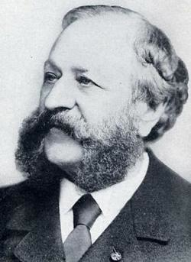

Notes:
Thomas W. Evans- a great dentist
Made his wealth through lucky investments

Slide 21

The Herman Ostrow School of Dentistry was renamed after a $35 million dollar donation by Herman Ostrow.
He practiced with the profession of dentistry for 17 years before getting into real estate development in the Los Angeles area, where he made most of earnings.

Slide 22
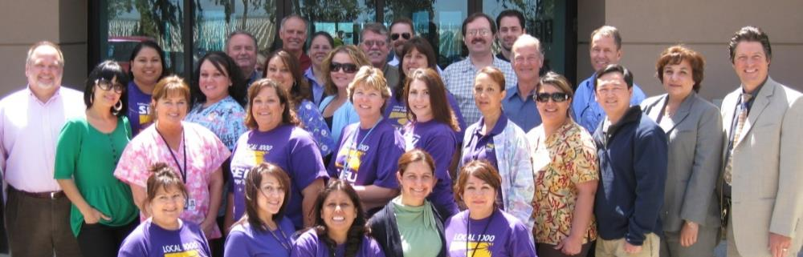
The Large Office
  Production-oriented
  Bosses/associates
  High overhead
  Higher revenue
  Rules
Notes:
An example of “corporate dentistry”

Slide 23
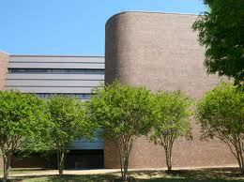
How about becoming a dental administrator?

Slide 24
How about an employee?
Notes:
You have more personal time

Slide 25
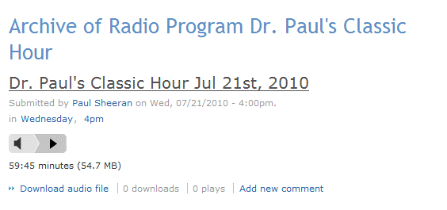
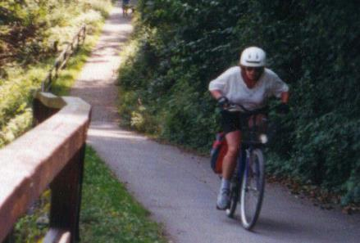


Notes:
Personal time

Slide 26


Notes:
Balance life

Slide 27
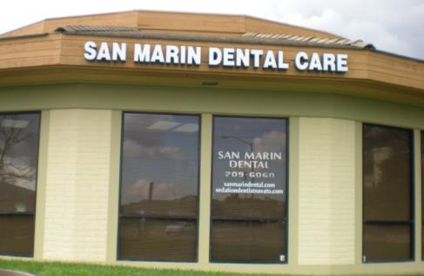
The “Classic” Hybrid Office
  One dentist
  Two to three dental assistants
  One hygienist
  One to two front office staff
  Four to five chairs
Notes:
Dr. Bone will speak more on this model later today

Slide 28
What is your Vision
Notes:
Audience interaction

Slide 29
What kind of Dentistry do you want to do?
Notes:
Audience interaction
Mine
Fixing a little ole lady denture that other people couldn’t do
Not a money dream
Office so friendly that people would come by just to say hi to the staff
Not a money dream
Making a difference to the world of dentistry

Slide 30
Who do you want to be?
What will you have accomplished?
What is your self Vision?
What are your criteria for success?

Slide 31
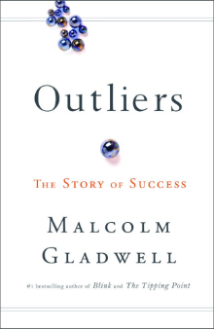



Notes:
Books on CD

Slide 32
How to be a Success
(in Dentistry)
Begin with the End in Mind
Work Diligently
Keep Your Integrity
Habits
Don’t Do it Alone

Slide 33
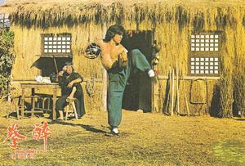

Work Diligently
“Work Hard”
Notes:
Karate Kid: Everything is Kung Fu; Work Hard; Be Strong; Be Brave
Inset- Jackie Chan as young man- incredible hard work to become a fighter
Larger picture- Jackie Chan as the teacher

Slide 34

Notes:
Review story of how the student faces difficulties, he worked harder than the other students, and then achieved his goal.
Allegory for many in overcoming difficulties- including the “test” to show him his weaknesses.
My model for getting through dental school

Slide 35
Work Diligently
90 percent of success is showing up.
Every day you do dentistry, your
dentistry muscles get stronger.
Don’t be discouraged by small defeats.
“Never, never, never give up.”
–Winston Churchill
Notes:
Includes Continuing Education
Story of the writer

Slide 36
Work Diligently
Once you decide on your vision
Write down strategies and tactics to what / how your expect your vision to come alive;
Work at it.
Get books, go to seminars, study, practice and practice
Did I tell you to practice?
Notes:
Includes Continuing Education

Slide 37
How to be a Success
(in Dentistry)
Begin with the End in Mind
Work Diligently
Keep Your Integrity
Habits
Don’t Do it Alone

Slide 38

Was he a success?
Notes:
End in mind
Lincoln was faced with defeat throughout his life. He lost eight elections, twice failed in business and suffered a nervous breakdown.
He could have quit many times – but he didn’t and because he didn’t quit, he became one of the greatest presidents in the United States history.
Known as “Honest Abe,” a model of integrity

Slide 39
Integrity
“Know Thyself.”
–Socrates
You are your brand
Notes:
See yourself as a brand.
Success By Arnold Schwarzenegger:
1. Trust yourself
Trust yourself, dig deep down and ask yourself: ‘who do you want to be?’. Not what, but who. Not what your parents or teachers wants you to be, but you! Figure out for yourself,
He urged the students to see themselves as a “brand” regardless of their career path. He said that every great brand is run by a leader with vision, the more specific the better. Schwarzenegger’s “vision” was to become the world champion in bodybuilding, which he believed would be his ticket to America. Once here he would become the world’s highest-paid movie actor and a successful businessman. Can you imagine how absurd this goal must have sounded spoken by a young man in a small Austrian village who didn’t speak English? He didn’t just dream big—he dreamed bigger than anybody else. “I refined this vision until it was very specific. I was going to go for the Mr. Universe title; I was going to break records in power lifting; I was going to Hollywood. The vision became so clear in my mind that I felt it had to happen,” he writes in Total Recall.

Slide 40

“Know Thyself.”
–Socrates
Notes:
What are your strengths? What are your weaknesses?
In dentistry, what do you gravitate toward. What do you need to work on?

Slide 41
Importance of Self-Esteem
Notes:
Don’t Let others put you down. How you see yourself, How you treat yourself is how others will treat you.
Old School Dental School
“New Age dental School”

Slide 42
Acknowledge Yourself
Treat Yourself Well
Take Care of Your Body
Transform Yourself
Notes:
Steps towards improving self esteem
1-Acknowledge yourself and your accomplishments. Recognize your blessings. What are your achievements? Which goals have been completed? What special people do you have in your life?
Memorize five of these.
2-Treat yourself as you would a good friend or loved one. What would your behavior be like? Would you criticize that friend or give that person your support? Would you do something special for the person? Would you try to meet that person’s needs as best you could?
Make a list of what you can or will do for yourself.
Schedule It.
3-Give your body what it needs. These behaviors include such activities as regular exercise, regular meditation, eating properly, giving yourself a vacation, mental rehearsal, and planning. These behaviors are not only stress protectors, but are also a way of showing yourself appreciatation.
4-If you are looking for your hidden jewel that’s hiding beneath your fears, angers, guilt, or resentments, then give it away.
We have a tendency to judge events and people outside of ourselves. Find out what is inside of you by looking at what you see outside of you. What you see reflects what is going on inside of yourself! This is the gift once you realize it is true.
You can also gain your hidden treasures by giving them away.
If you want to make your life more worthwhile, then look around your for worthwhile things.
If you want to feel better about yourself, then notice the better things in the world.
If you want more love, then give it away.
If you want more prosperity, then give some away
The process of transformation occurs when you make a smal internal change…

Slide 43
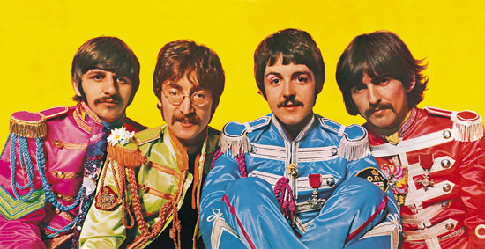
Importance of Self-Esteem
And in the end
The love your take
Is equal to the love
You make
- Lennon and McCartney

Slide 44
Esteem Yourself
“As a Man Thinketh in his heart, so He is … ”
–Proverbs

Slide 45
You are your brand
Notes:
See yourself as a brand. I was in the audience one day when Schwarzenegger offered advice to California high school students attending a leadership conference in Sacramento. He urged the students to see themselves as a “brand” regardless of their career path. He said that every great brand is run by a leader with vision, the more specific the better. Schwarzenegger’s “vision” was to become the world champion in bodybuilding, which he believed would be his ticket to America. Once here he would become the world’s highest-paid movie actor and a successful businessman. Can you imagine how absurd this goal must have sounded spoken by a young man in a small Austrian village who didn’t speak English? He didn’t just dream big—he dreamed bigger than anybody else. “I refined this vision until it was very specific. I was going to go for the Mr. Universe title; I was going to break records in power lifting; I was going to Hollywood. The vision became so clear in my mind that I felt it had to happen,” he writes in Total Recall.

Slide 46
You are Your Word
Notes:
Daily Meditation on who you want to be
Play the movie in your head
Detail

Slide 47
If you know the patient and know yourself, you need not fear the result of a hundred encounters.
If you know yourself but not the patient, for every success you will also suffer setbacks.
If you know neither the patient nor yourself, you will fail.
- Sun Tzu (Paraphrased)

Slide 48
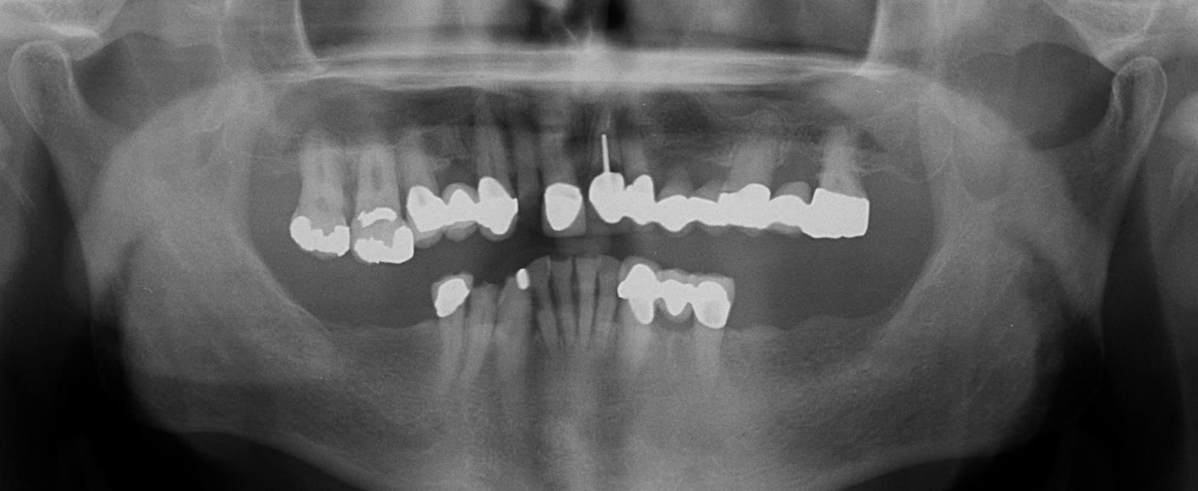
Who are you?
What are your skills?
What can you accomplish?
Who is your patient?

Slide 49
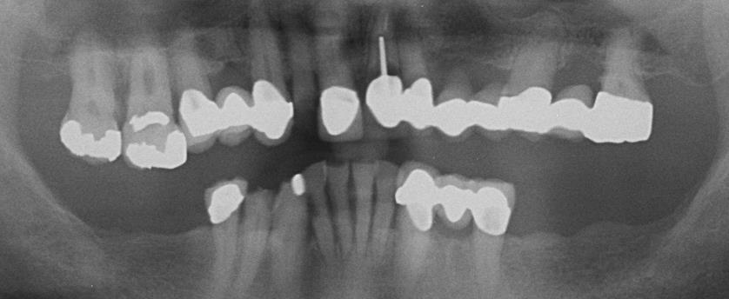
Who are you?
What are your skills?
What can you accomplish?
Who is your patient?

Slide 50
How to be a Success
(in Dentistry)
Begin with the End in Mind
Work Diligently
Keep Your Integrity
Habits
Don’t Do it Alone

Slide 51

“Do or do not ... there is no try.”
Is he a Success?

Slide 52
Discipline
“We are what we repeatedly do.
Excellence then is not an act, but a habit.”
–Aristotle

Slide 53
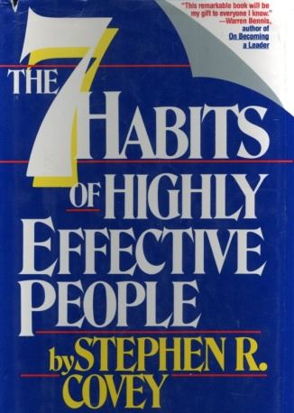
Good Habits = Success

Slide 54
Be Proactive
Begin with the End in Mind
Put First Things First
Think Win/Win
Seek First to Understand, Then to Be Understood
Synergize
Sharpen your Saw

Slide 55
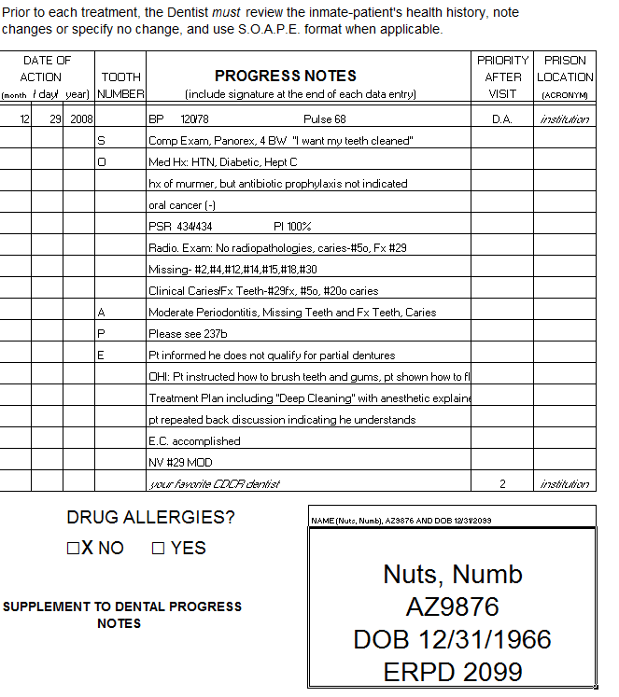
Notes:
Hate writing notes?
Do it the same everytime
Habits

Slide 56
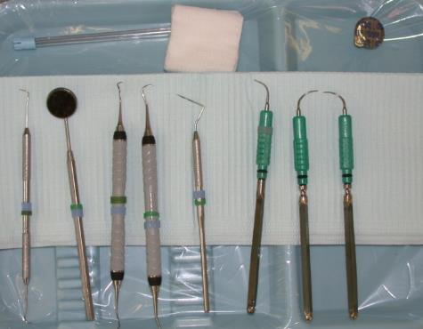
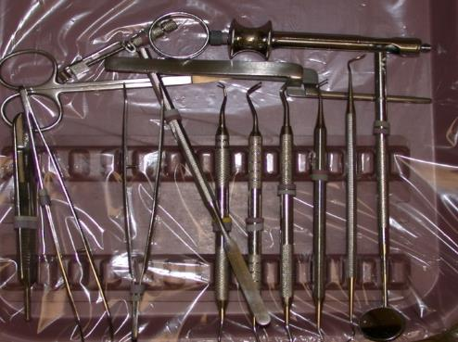
Consistent Tray Setups
Notes:
Key to success between different sites?
Working to THEIR habits

Slide 57
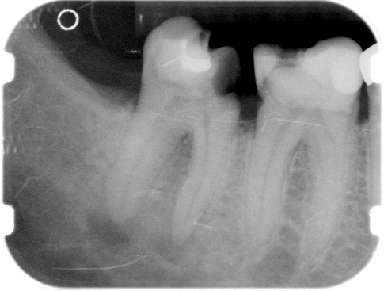
Mental Discipline
Notes:
Recent California AGD Meeting
Key to better success in endo
The technique
The equipment
no
taking the time to make the correct diagnosis and treatment plan
This must be a habit
#30 is the culprit, not #31. take all of the steps to pulp test

Slide 58
How to be a Success
(in Dentistry)
Begin with the End in Mind
Work Diligently
Keep Your Integrity
Habits
Don’t Do it Alone

Slide 59

Is he a Success?

Slide 60

Have a Team

Slide 61
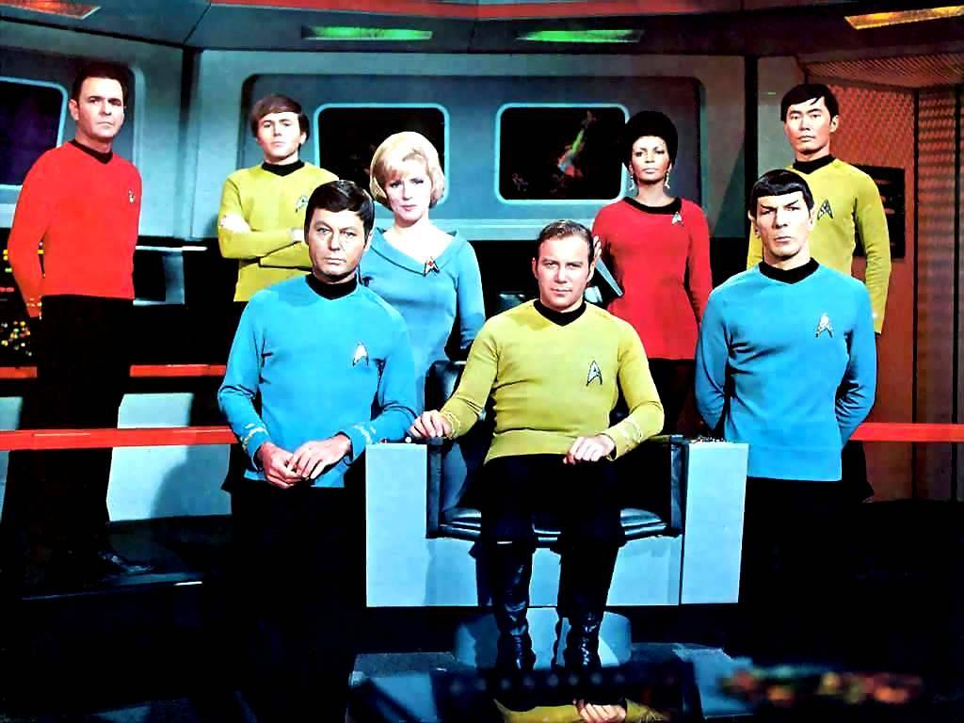
Whose your team?

Slide 62

Belong to Organized Dentistry
Camaraderie
Access to Valuable Information
Great Continuing Education
Representation

Slide 63

Notes:
Old series
I always wondered- why wasn’t Spock the best commander?

Slide 64
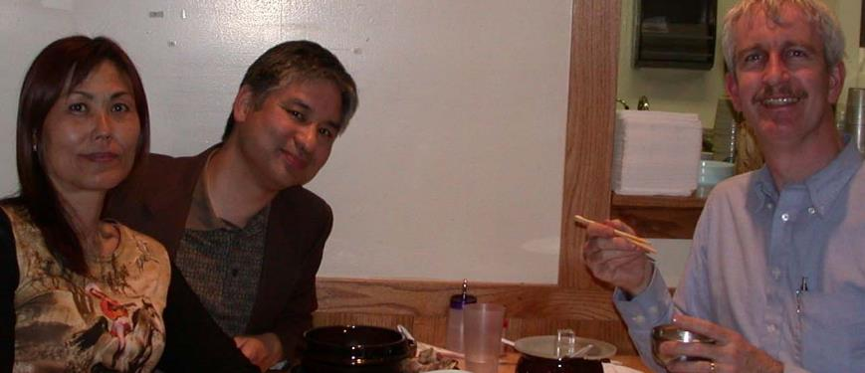
Don’t Go It Alone
Get involved locally
Develop your leadership skills
Get involved with advocacy

Slide 65
Student Transition Manual

Slide 66


Slide 67
Key Forces Affecting Dentistry
Trends in
Insurance
Benefits
New
Dental
Schools
The Economy
Rising
Student
Debt
Dentistry
Corporate
Practices
Midlevel
Providers
Health Care
Reform Act
Changes in
Oral Health
Status
Notes:
It is important, when prioritizing issues, to parse those we can readily influence from those more difficult.
Third-party issues can only be influenced to a certain degree, either through negotiation (CDBP), legislative advocacy (CGA) or by individual dentists making independent decisions. NCS example, both good and bad.
2. Regulatory compliance can be influenced through official comments, policy and advocacy/relationships with governmental agencies.
Midlevel provider issues can be influenced through advocacy and policy to some extent, but complete control may not be possible.
The other issues on this chart may be influenced, but to a lesser degree, for instance, Health Care Reform Act may still be influenced through advocacy in how it is implemented.

Slide 68
Demand for Dental Services
• Population
• Family Income
• Dental Insurance
• Oral Health
• New Technology

Slide 69
Demand for Dental Services
• Population
Increased demand
Increasing population is the primary reason for the increasing the number of dental schools
Notes:
Projections of increasing population, especially amongst Hispanics

Slide 70
Demand for Dental Services
• Family Income
Decreased Demand
Lost of wealth in the middle class decreased the money available for families to spend on routine dental care
Notes:
Harry Dent
Population Growth X Consumer Spending
Probably will flatten for the next 5 years
Money in children’s dentistry from Obama Care

Slide 71
Demand for Dental Services
• Dental Insurance
Historically increased demand
More funds available to ordinary Americans

Slide 72
Demand for Dental Services
• Dental Insurance
Decreases demand
Less funds available to ordinary Americans

Slide 73
Declining Insurance Coverage
Source: Kaiser Health Foundation.

Slide 74
Delta Dental of California is reducing reimbursement to its Premier Providers.
It is likely these reductions will average 8 to 10 percent and may vary by region and provider.

Slide 75

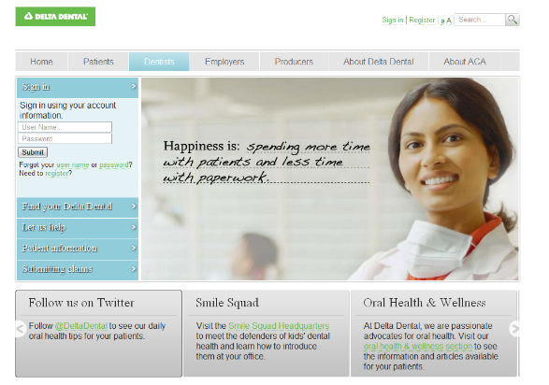
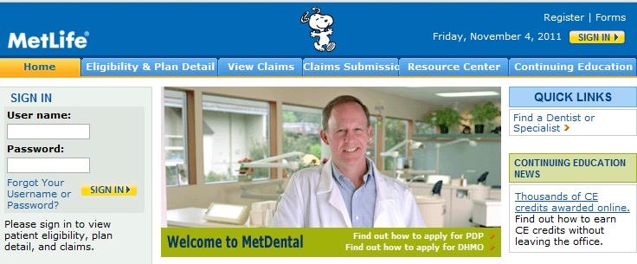
As Dentistry becomes a Commodity, What can you Do?
Notes:
Ask Dr. Bone about this

Slide 77
Demand for Dental Services
• Oral Health
Lowered Demand
Oral Hygiene has improved amongst the middle class decreasing the restorative and emergency services requested by the middle class

Slide 78
Demand for Dental Services
• New Technology
Increased demand
New opportunities and services by the profession
(eg Dental Implants and Cosmetic Dentistry)

Slide 79
Demand for Dental Services
• New Technology
Decreased demand
Technology increases productivity
(eg Dental Radiography, Cerac)

Slide 80
Dentist Supply
Population to Dentist Ratio
Improvements in Productivity in the Delivery of Dental Services
Recent and Future Expansion of the Education of Dentists

Slide 81
Dentist Supply
Population to Dentist Ratio
2000:1
From the ‘60s
Doesn’t include population’s
utilization rate
ability to pay for services
differences between dentists

Slide 82
Dentist Supply
Recent and Future Expansion of the Education of Dentists
A 20% increase or 1000 dentist per year above our current number of graduates
12 dental schools have opened or are opening since 1997

Slide 83
New Dental Schools
In the “60s and 70s” the dentist population was dramatically increased by the government because of a perceived shortage. 4 handed dentistry became the norm. The “80s” had a lack of business problem followed by the closure of many schools in the “90s”. We are recently are under an access to care problem…multiple new schools are being opened, multiple new hygiene programs are being opened…

Slide 84
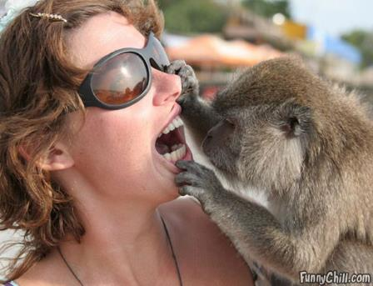
Mid-Level Provider
Current ADA policy states that "the ADA is opposed to nondentists making diagnoses, developing treatment plans, or performing irreversible procedures."

Slide 85
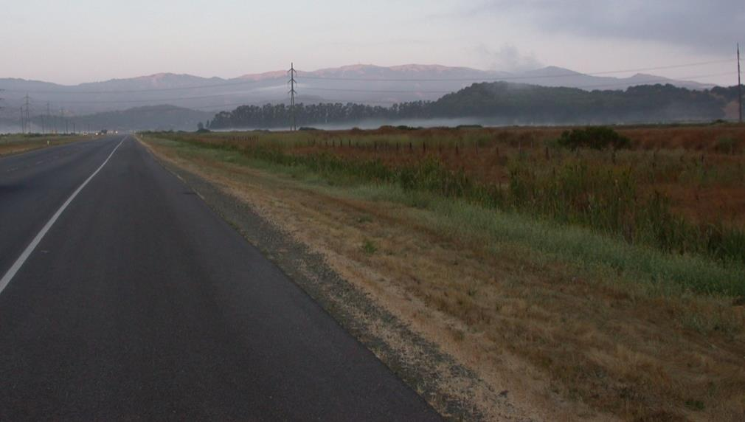
Notes:
The road is long
Which road
ADA become more efficient (so you can do the lower cost models)
Join corporate
Focus on the customer and make the insurance secondary
Become a boutique practice
Go where there is no competition

Slide 86
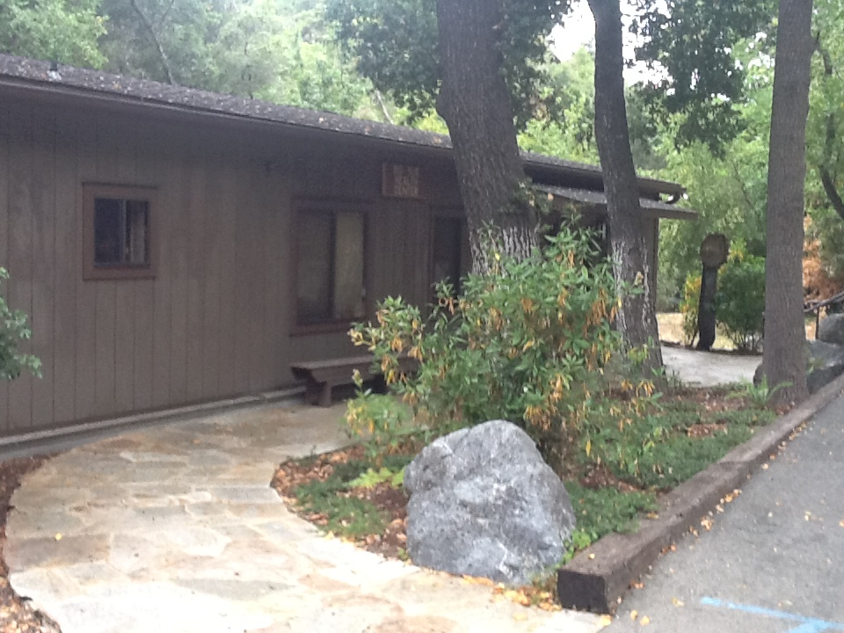
Notes:
The road is long
Which road
ADA become more efficient (so you can do the lower cost models)
Join corporate
Focus on the customer and make the insurance secondary
Become a boutique practice
Go where there is no competition
Big Sur

Slide 87

Notes:
Commute view to Big Sur Health Center

Slide 88


Slide 89
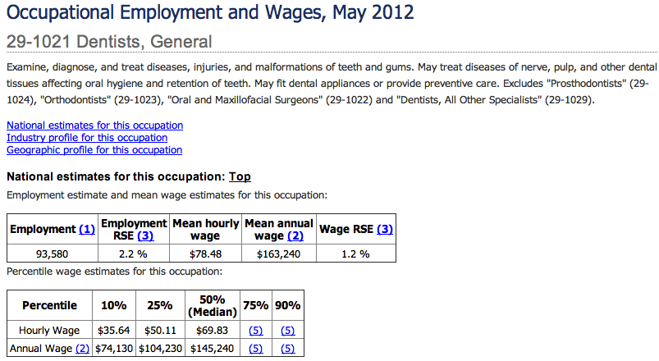

Slide 90
Annual Mean Wage by State
Notes:
Tenn- 161k-186k
Ky- 150k-160k
Tx-187k-234k
Ca-46k-149k

Slide 91
Wages by locality

Slide 92
Top paying non metropolitan areas

Slide 93
Top paying metropolitan areas

Slide 94
Where are the dentists?

Slide 95
Salary
Medical / Dental
Vacation Days
Sick Days
Continuing Education
Pension
Retirement Plan

Slide 96
Salary 120,000
Medical / Dental 008,000
Vacation Days (12x500) 006,000
Sick Days (12X500) 006,000
Pension (1,700,000/20) 085,000
Retirement Plan -0- 225,000

Slide 97
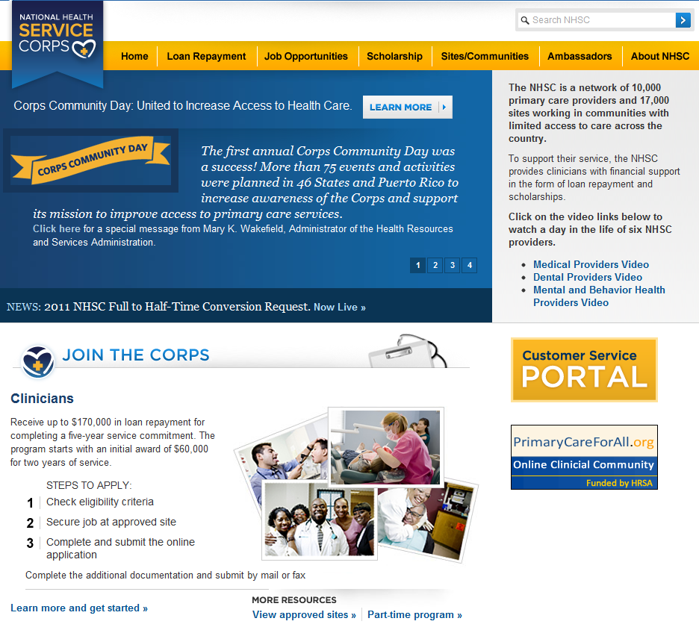

Slide 98
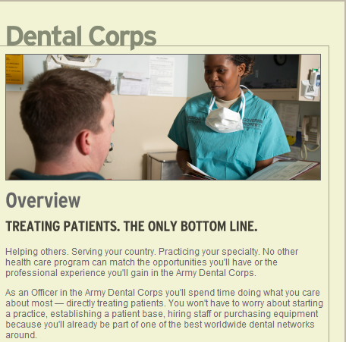

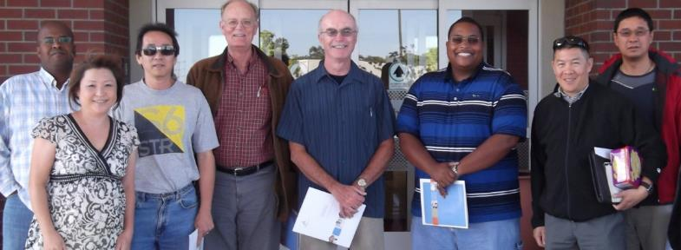

Slide 99
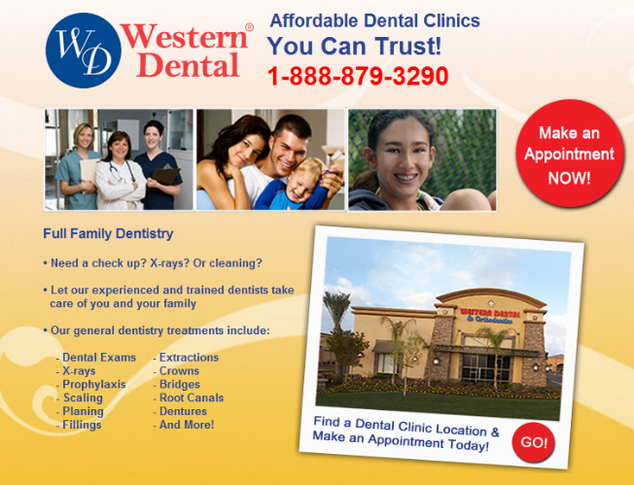
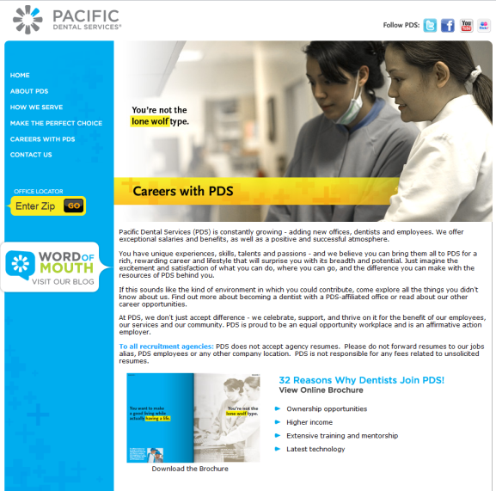
Internet ads shown are not
endorsements by the AGD.

Slide 100
Internet ads shown are not
endorsements by the AGD.

Slide 102

Notes:
6 Secrets To Success By Arnold Schwarzenegger:
1. Trust yourself
Trust yourself, dig deep down and ask yourself: ‘who do you want to be?’. Not what, but who. Not what your parents or teachers wants you to be, but you! Figure out for yourself,
2. Break the rules
3. Don’t be afraid to fail
4. Don’t listen to the naysayer
5. Work your butt off!
6. Give back

Slide 103
Conclusions?
Large Group Practices
Small Group Practice
Purchase your practice
Niche Practice
Focused “Lean and Mean” Practice
Small Office with 45% overhead
Notes:
Large Group- Chain Practices
Small Group- with specialties contained in the practice – maybe you manage
Small Group- not just dental, but dental is a component
Sleep Problems
Headache Clinics
Beauty Clinics
Wellness Clinics

Slide 104
Large Group Practices
Chain Practices/Corporate Practices
Government/Military
DHMO Clinics
Notes:
Large Group- Chain Practices
Small Group- with specialties contained in the practice – maybe you manage
Small Group- not just dental, but dental is a component
Sleep Problems
Headache Clinics
Beauty Clinics
Wellness Clinics

Slide 105




Notes:
Expensive Equipment and Techniques become affordable

Slide 106
Large Group Practices
DHMO Clinics
LEPAAT
Capitation Payment + Co-payment+CoPay + “Bonus”
-(Utilization Rate/ Total Office hours)* Total office Expenses
PROFIT
Is it enough for you?
Notes:
Least Expensive Professionally Acceptable Alternative Treatment
Treatment Cost Units ( not marginal costs)

Slide 107
Cover Letter Tips
1. Research the practice that is offering the job, then customize your cover letters specifically to each job you are applying for rather than using a generic cover letter for all opportunities.
2. Always include the names and contact information for professional references and give permission for them to be contacted by the prospective employer.
Just writing “references available upon request” creates a barrier in the process of getting your foot in the door when the prospective employer has to then take an extra step to find out more about you by asking for your references.

Slide 108
3. Highlight important aspects of the job that will pertain to your job as a dentist, such as your ability to work with others and how reliable you are.
4. Know that many dentists refer pedo, endo and oral surgery out to specialists, offer these skills and interests to a potential employer.
5. Put some personality in your cover letter. Be professional of course, but remember, you are selling you.

Slide 109
6. Find someone who has been on the hiring end of employment opportunities in the past will be able to give you perspective that you may lack as a new dentist looking for a job, someone who is willing to read and help you edit your résumé and cover letter.
7. Always spell-check your work.

Slide 110
Small Group Practice
Public Health
Small Group-Shared Space
Small Group- Dental Specialties under one roof
Small Group-theme clinics
(Sleep Clinics; Headache Clinics; Beauty Clinics; Wellness Clinics; Diabetes Clinics)
Notes:
Large Group- Chain Practices
Small Group- with specialties contained in the practice – maybe you manage
Small Group- not just dental, but dental is a component
Sleep Problems
Headache Clinics
Beauty Clinics
Wellness Clinics

Slide 111



Slide 112


Slide 113


Slide 114


Slide 115
Management
Inspect what you Expect
Exemplify what you want others to do
Communication
Emotional IQ (EQ)

Slide 116
Management
Train, Train, train, train, train some more

Slide 117
Niche Practice
Boutique Practice
Personalize Service Practice
High Service
Notes:
Large Group- Chain Practices
Small Group- with specialties contained in the practice – maybe you manage
Small Group- not just dental, but dental is a component
Sleep Problems
Headache Clinics
Beauty Clinics
Wellness Clinics

Slide 118
ABC of Selling
Always be Closing
Find their Pain – and answer it!
A No is okay in sales
Notes:
Glengarry Glen Ross

Slide 119








Slide 120
ABC of Selling
A – Availability for your customers is essential, so they can reach you.
B – Believe in yourself and your product.
C – Customers aren’t always right, but if you want to keep them as your customers, find a way to make them right.

Slide 121
Focused “Lean and Mean” Practice
“McDonaldization
A focus on operations
Just a few basic procedure, but done well and done fast
perhaps the best model for the upcoming Winter
Refer out a lot
Notes:
Large Group- Chain Practices
Small Group- with specialties contained in the practice – maybe you manage
Small Group- not just dental, but dental is a component
Sleep Problems
Headache Clinics
Beauty Clinics
Wellness Clinics

Slide 122

Small Office with 45% overhead
Your patients are there because of you
Notes:
Large Group- Chain Practices
Small Group- with specialties contained in the practice – maybe you manage
Small Group- not just dental, but dental is a component
Sleep Problems
Headache Clinics
Beauty Clinics
Wellness Clinics

Slide 123

“be careful what you wish for” …

Slide 124

So Where Do You Begin!
James S. Bone, MS, DDS, MAGD
AGD Dental Education Council
Private Practice
Part-time faculty AEGD Residency
University of Texas Health Science Center
San Antonio
Notes:
Dr. Lew told you everything you need to know. So let’s bring some of it to life.

Slide 125
A Plan
Write down where you are today
  Associateship, partner, sole practitioner, student
  All Debt (student loan, home, practice, auto)
Write down where you want to be in the future
  Associateship, partner, sole practitioner, student
  All Debt (student loan, home, practice, auto)
Connect the Dots!

Slide 126
A Written Plan
You are more likely to follow through if it is in writing
It allows you to more easily evaluate your progress
It can be adjusted as needed
It should have defined milestones and deadlines
It solidifies your commitment

Slide 127

Education
Education is not filling a bucket, but lighting a fire.
- William Yeats
Notes:
Sometimes we are just lucky. I was lucky to get this photo. …. However, I had to be in the right place for this luck to have happened.

Slide 128


AGD Fellowship Award (FAGD)
Earn 500 CE hours
Pass Fellowship Exam
3 Years of AGD membership
Attend Convocation
3

Slide 129
Achieving Fellowship
State License Requirement
  12–25 continuing education hours per year
Fellowship Award
  500 continuing education hours
Takes between 20–40 years to reach Fellowship
  500 / 12 = 41.67 years
  500 / 25 = 20 years

Slide 130


AGD Mastership Award (MAGD)
Become an AGD Fellow
Earn 1,100 CE hours
(400 participation)
Attend Convocation

Slide 131
Mastership Discipline Breakdown
Subject Subject Participation Required
Category Code Minimum Minimum
Basic Sciences......................................010............................................ 12...........................................................12
Endodontics ........................................070............................................ 30...........................................................46
Electives ..............................................130............................................ 30...........................................................46
MPD/Occlusion ...................................180............................................ 30...........................................................46
Operative Dentistry ............................ 250........................................... 30...........................................................46
Oral & Maxillofacial Surgery............... 310............................................30...........................................................46
Orthodontics .......................................370............................................12...........................................................12
Pediatric Dentistry ..............................430.............................................12......................................................... 12
Periodontics.........................................490............................................ 30.......................................................... 46
Practice Management......................... 550.............................................. 0 ..........................................................24
Fixed Prosthodontics .......................... 610.............................................30.......................................................... 46
Removable Prosthodontics ................ 670.............................................30.......................................................... 46
Implants ............................................. 690............................................ 30......................................................... 46
Oral Med/Oral Diagnosis .................... 730.............................................12......................................................... 12
Special Patient Care.............................750............................................. 12......................................................... 12
Esthetics ..............................................780............................................ 30......................................................... 46
TOTAL HOURS.................................................................................. 360.................................................. 544
TOTAL REQUIRED ..............................................................................400.................................................. 600

Slide 132
Achieving Mastership
State License Requirement
  12–25 continuing education hours per year
Mastership Award
  1,100 continuing education hours
Takes between 44–90 years to reach Mastership
  1,100 / 12 = 91.67 years
  1,100 / 25 = 44 years

Slide 133
Lifelong Learning and Service Recognition (LLSR)
Must be a Master (MAGD)
Earn an additional 500 continuing education hours
  150 participation hours
  At least 8 of the 17 disciplines must be represented
100 Hours of Service or Volunteerism:
  Serving on a dental board
  Service in a volunteer dental clinic
  Mission dentistry
  Community service
    Presentation at schools
    Health fairs

Slide 134
Where Do I Get Education?
Local AGD
State AGD
National AGD
Study Clubs
AGD Website
New Dentist Study Club
Webinars

Slide 135


New Dentists Study Club
S A F E
San Antonio Fellowship Exchange
Texas Academy of General Dentistry
New Dentists Study Club

Slide 136

New Dentists Study Club

Slide 137

How Student Debt Affects
Small Business Success
Oct 29, 2012 | Written by: Matt Thompson

Slide 138
How Student Debt Affects
Small Business Success
Oct 29, 2012 | Written by: Matt Thompson

Slide 139
How Student Debt Affects
Small Business Success

Slide 140
How Student Debt Affects
Small Business Success
It’s no secret: college tuition has been rising faster than inflation and pay-raises since the 1980s. The Department of Education expects public college tuition to more than double between 2001 and 2016. That’s even faster than skyrocketing medical costs that demand so much attention from the media and politicians.

Slide 141
How Student Debt Affects
Small Business Success
Many students have had to make difficult choices that their parents would never have imagined. College students who thought they could handle loan repayment now find that they can’t afford to purchase homes or cars.

Slide 142
How Student Debt Affects
Small Business Success
Student debt also has a less direct impact on small business success. College graduates struggling to keep up with loan payments can neither afford homes and vehicles, nor can they afford to start their own businesses. Banks aren’t much help, either. Small business lending has been depressingly low since the recession started. Lenders certainly aren’t giving a thumbs up to graduates already saddled with thousands of dollars in debt.

Slide 143

How Are You Going To Manage Debt?

Slide 144
Debt Ratio
Calculating the debt-to-equity ratio is simply a matter of taking the amount of money a company uses to finance its operations and dividing that by the total available capital.
Target less than 1
Example:
$300,000 student loan
$100,000 salary
$400,000 capital
$300,000
÷$400,000
0.75 Debt Ratio

Slide 145
Debt Ratio
Good Debt
Bad Debt
Real Estate
  House
Business
  Dental Practice
Certain Equipment
  X ray unit
Student Loan
  Investment in yourself
Automobile
  Necessary Evil
  Don’t over buy
Expensive Toys
  Boat
Food/Clothes
  Do not finance
“Must Haves!”
  Don’t buy it if you
  don’t need it
Notes:
House goes up in value and you have to live somewhere
Business usually goes up in value and provides income
Xray unit produce the largest amount of revenue per time. You hire someone let say that is paid $15/hr to take xrays and everytime they push that button they generate about $20/min.
Car goes down in value from the moment you drive off the lot, and it sucks liquid cash (gas), so buy as little as you can actually get away with.
Boat- Cost a lot, requires a lot of maitanance, requires storage, and you use it for a few hours on occasional weekends.
If you have credit card debt of which some is eating out, you really need to re-eval your situation.

Slide 146
Debt Management
Student Loan Payments $3000
  $275,000 principle
  Terms: ≈10 years @ 6.9%
Additional Principle Payment $3000
  Once a year
  Save about $9000 in interest
  Only $250/month

Slide 147
Debt Management
Home Loan Payments $1350
  $300,000 principle
  Terms: 30 years @ 3.5%
Additional Principle Payment $1350
  Once a year
  Save about $26,000 in interest
  Payoff approx 25 years

Slide 148
Debt Management
What if I don’t have $1350 extra a year?
  $112 extra a month?

Slide 149
Debt Management
Average person spends $10,000 annually on Credit Card.
    Cash Back Reward (1%) $100
Business Owners
  Dental Supplies $30,000
    Cash Back Reward $300
  Continuing Educations $12,000
    Cash Back Reward $120
  Lab Fee $60,000
    Cash Back Reward $600
  Office Supplies $12,000
    Cash Back Reward $120
  Other $10,000
    Cash Back Reward $100
Total $1,340
Notes:
Who owns the point for business credit card. Well the business does but if the business saved money, then you can take some extra home, after tax.

Slide 150

Practice Purchase
Most of you will buy out/buy
into a practice at some point.

Slide 151


Buying A Practice
Practice values vary quite a bit geographically
Average single doctor practice is producing about $600K
Selling at 50 to 85% of gross

Slide 152

Practice Purchase
Practice Annual Gross Revenue $600,000
Practice Purchase Price
(let’s assume 2/3 Annual Revenue) $400,000
Monthly Payments based on 7 years @ 7% $6,040
Add in Student Loans ($1,000–$4,000) $3,000
  Based on $275,000 amortized for 10 years @ 6%
Living Expenses ($60,000) $5,000
Total Monthly Need $14,040
Assume a 70% Overhead
  > your monthly revenue needs to be $46,800
Annual Revenue $561,600

Slide 153
Afraid You Can’t Produce That Amount?
What Does It Take To Produce
$600,000 annually?

Slide 154
8:00 | Large
8:15 | Procedure
8:30 | (Crown/Implant/
8:45 | Endo/3rds)
9:00 |  | Suture Removal
9:15
9:30 | New Patient
9:45
10:00
10:15
10:30
10:45
11:00 | (Fillings/Extraction)
11:15
11:30
11:45
12:00 | Lunch | Lunch
1:00 | Wax Rim Try in
1:15 | Bite Registration
1:30 | Tooth Selection
1:45
2:00 | New Patient
2:15
2:30
2:45
3:00
3:15
3:30 | Crown Seat
3:45
4:00
4:15 | Emergency
4:30
4:45
Doctor’s Schedule
Emergency
Crown $1000
New Pt Exam $185
Restorations (2) $375
Wax Rim Try in $0
New Pt Exam $185
Crown Seat $0
Emergency $230
Suture Removal $0
Quick Emergency (x2) $200
Total $2,175
Emergency

Slide 155
8:00 | Prophy
8:15
8:30
8:45
9:00 | Child Prophy
9:15 | Fluoride
9:30
9:45 | Child Propht
10:00 | Fluoride
10:15
10:30
10:45
11:00 | Prophy
11:15
11:30
11:45
12:00 | Lunch | Lunch
1:00 | Prophy
1:15 | BTW x 4 / EXAM / Fl
1:30
1:45 |  | Periodic Exam
2:00 | Prophy
2:15 | Fl
2:30
2:45
3:00 | Prophy
3:15 | BTW X 4 / EXAM
3:30
3:45 |  | Periodic Exam
4:00
4:15
4:30
4:45
Hygiene Schedule
Adult Prophy $80
Child Prophy $60
Fluoride $35
Child Prophy $60
Fluoride $35
Adult Prophy $80
Adult Prophy $80
BTWx4 $55
Periodic Exam $45
Fluoride $35
Adult Prophy $80
Fluoride $35
Adult Prophy $80
BTWx4 $55
Periodic Exam $45
Total $860

Slide 156
Usual Total Production
Doctor’s Production: $2,175
Hygiene Production: +$ 860
Total Daily Office Production: $3,035
Based on 4.5 work days = Weekly Production: $13,658
Monthly Production: $54,632
Annual Production: $655,584

Slide 157
8:00 | Large
8:15 | Procedure
8:30 | (Crown/Implant/
8:45 | Endo/3rds)
9:00 |  | Crown Seat/Post OP
9:15 |  | Denture Adj
9:30 | New Patient | Crown Seat/Post OP
9:45 |  | Denture Adj
10:00
10:15
10:30 | Small
10:45 | Procedure
11:00 | (Fillings/Extraction)
11:15 |  | Crown Seat/Post OP
11:30 | Emergency | Denture Adj
11:45
12:00 | Lunch | Lunch
1:00 | Large
1:15 | Procedure
1:30 | (Crown/Implant/
1:45 | Endo/3rds)
2:00
2:15 |  | Crown Seat/Post OP
2:30 | New Patient | Denture Adj
2:45
3:00
3:15
3:30 | Small
3:45 | Procedure
4:00 | (Fillings/Extraction)
4:15 |  | Crown Seat/Post OP
4:30 | Emergency | Denture Adj
4:45
Emergency
Doctor’s Schedule
Molar Endo $915
New Pt Exam $185
Restorations (3) $570
Emergency $230
Crown $1000
New Pt Exam $185
Filling (2) $375
Extraction $150
Emergency $230
Quick Emergencies x 4 $400
Total $4,240
Emergency
Emergency
Emergency

Slide 158
8:00 | SCRP X 2 | Anesthesia
8:15 | UL/LR
8:30
8:45
9:00
9:15
9:30 | Child Prophy
9:45 | BTW x 2/ EXAM / Fl
10:00 |  | Periodic Exam
10:15 | Child Prophy
10:30 | BTW x 4 / EXAM / F
10:45 |  | Periodic Exam
11:00 | Prophy
11:15
11:30
11:45
12:00 | Lunch | Lunch
1:00 | Prophy
1:15 | BTW x 4 / EXAM / Fl
1:30
1:45 |  | Periodic Exam
2:00 | Prophy
2:15 | Fl
2:30
2:45
3:00 | Prophy
3:15 | BTW X 4 / EXAM
3:30
3:45 |  | Periodic Exam
4:00 | Prophy
4:15 | Fl
4:30
4:45
Hygiene Schedule
SCRP $230
SCRP $230
Child Prophy $60
BTWx2 $40
Fluoride $35
Periodic Exam $45
Child Prophy $60
BTWx4 $55
Fluoride $35
Periodic Exam $45
Adult Prophy $80
Adult Prophy $80
BTWx4 $55
Periodic Exam $45
Fluoride $35
Adult Prophy $80
Fluoride $35
Adult Prophy $80
BTWx4 $55
Periodic Exam $45
Adult Prophy $80
Fluoride $35
Total $1,540

Slide 159
Total Production
Doctor’s Production: $4,240
Hygiene Production: +$1,540
Total Daily Office Production: $5,780
Based on 4.5 work days = Weekly Production: $26,010
Monthly Production: $104,040
Annual Production: $1,248,480

Slide 160

Need to Average $2,700 Daily
Daily Revenue: $2,700
Weekly (4.5 days/wk): $12,150
Monthly (4 wks/month): $48,600
Annual Revenue: $583,200
$583,200 > $561,600

Slide 161
Not Good Enough!
Daily Revenue with Hyg: $3,035
Weekly (4.5 days/wk): $13,658
Monthly (4 wks/month): $54,630
Annual Revenue: $655,560
$655,560 > $561,600
Your Take-Home (70% OH): $196,668

Slide 162

Practice-By-Numbers!
“A great building must begin with the unmeasurable, must go through measurable means when it is being designed and in the end must be unmeasurable.”
–Louis Kahn

Slide 163

Define Success

Slide 164

Success Is Not Easily Measured

Slide 165

Profitability is Measurable
How Profitable Do You Need To Be?
Do You Know When You Are
Not Being Profitable?
Notes:
The more profitable we are the more we can be successful at what ever we define as success.

Slide 166
How do you know how
well you’re doing?
How do you know where
the problems are?

Slide 167

Industry Norms
Dental Supplies 4–8%
Continuing Education 2%
Employee Expenses 17–20%
Employee Benefits 1%
Hygiene Salaries 8–10%
Lab Fees 4–10%
Legal/Accounting/Professional Serv. 1–2% ($1,000–$,8000)
Taxes/Payroll <3%
Office Expenses 1–3%
Rent/Lease/Facility 2–3%, <7%
Repairs & Maintenance <1%
Advertising/Promotion/Marketing 1–5%

Slide 168

Business by the Numbers
Too High or Too Low may be an indication of a problem!
Be able to justify why you operate outside the industry norms.

Slide 169
Lab Fees
Total Income: $788,008.90
Laboratory Fees: $96,966.55
$96,966.55 / $788,008.90 = .123 or 12.3%
Industry Norm: 4–10%
Considerations:
Lab fees are too high; check around with other labs
Procedures requiring lab are priced too low; raise fees
Very high portion of practice designated to Crown/Bridge/Dentures

Slide 170
Payroll
Total Income: $788,008.90
Payroll Expense: $213,707.69
$213,707.69 / $788,008.90 = .271 or 27.1%
Industry Norm: 17–23%
Considerations:
Salaries too high, be careful with raises
Production and/or Collections are too low; increase Production/Collection
May be overstaffed, consider technology to relieve need for staff
Long-term employees continue to get raises, yet their
performance levels do not spur any additional production

Slide 171
Supplies
Total Income: $788,008.90
Dental Supplies: $64,591.46
$64,591.46 / $788,008.90 = .082 or 8.2%
Industry Norm: 5–8%
Considerations:
Too many supplies in inventory; order smaller
quantity/only what you need
Supplies are too expensive per your collections,
consider different supplier
Fees are not high enough for your supply, consider
raising fees
Consider cheaper supplies

Slide 172

Continuing Education
Too high:
Spending too much time in CE vs.
Production in your office
Not implementing new technologies
learned
Too low:
Can’t afford to go to the John Kois
Institute yet?
You’re not keeping up with the rest of
the pack on education!

Slide 173

Professional Services
1–2%
Accounting, Legal, Bookkeeping, Practice Management, Payroll Service
Considerations:
Doing your own: Payroll, Bookkeeping
- Invest in Software (Quickbooks, Peachtree)
- Practice Management Company (ROI not
sufficient; not applying systems
appropriately)

Slide 174

Rent / Lease / Facility
Rent > 3%
Consider Location
- Is the real estate too high for dental practice?
Consider Facility Size
- Too much space?
Consider Increasing Production/Collections
Own Building < 7%
Can afford higher percentage when owning
Tax advantages
Investment

Slide 175
How Much Space
Do You Need?
Rule of Thumb:
1–7 Operatories = # of Ops x 450 sq. ft.
8+ Operatories = # of Ops x 400 sq. ft.
Example:
4 Ops x 450 = 1,800 sq. ft.
10 Ops x 400 = 4,000 sq. ft.

Slide 176

1%
Data from ADA
Dental Supplies ≈ 4-8% (Suggest 4-6%)
1% of $600,000 is $6000

Slide 177
Industry Norms
Dental Supplies 4–8%
Continuing Education 2%
Employee Expenses 17–20%
Employee Benefits 1%
Hygiene Salaries 8–10%
Lab Fees 4–10%
Legal/Accounting/Professional Serv. 1–2% ($1,000–$,8000)
Taxes/Payroll <3%
Office Expenses 1–3%
Rent/Lease/Facility 2–3%, <7%
Repairs & Maintenance <1%
Advertising/Promotion/Marketing 1–5%
An Average of 1% in all categories would give you about $60,000 additional profit.

Slide 178

Start Thinking Business

Slide 179
Using Cash Flow Quadrant
Associateship
Public Health
Government
University
Practice with Employee Dentists
Secondary Business Owner
Hygiene
Product Sales
E
B
S
I
Solo Dentist
Partnership Dentists
Group Practice
Lease Property
Home Owner
Stocks, Bonds, Savings

Slide 180
Cash Flow Quadrant
E
B
S
I

Slide 181
Cash Flow Quadrant
E
B
S
I

Slide 182

Wealth Accumulation
What if I told you don’t have to make a lot if money to be RICH?!
What if I told you don’t need DISCIPLINE?!
Would you be INTERESTED?!

Slide 183
If You Can Answer “Yes” to These Questions, You Have a Good Chance of Becoming a Millionaire
Do you know your Latte Factor?
Do you “Pay Yourself First”?
Have you made your financial plan automatic?
Do you own your home?
Do you tithe?

Slide 184

What is Your Latte Factor?
“The Automatic Millionaire”
By David Bach
Track your Expenses for 1 week to locate your LATTE FACTOR

Slide 185

My Latte Factor
Dining Out
$7,576.64 at restaurants
30 years x 10 percent = $150,300.83
$1,577,550.30

Slide 186


Slide 187
There are 6 Primary Ways to Get Rich in this Country:
Win It
Marry It
Inherit It
Sue For It
Budget For It
Pay Yourself First

Slide 188

Win It
Have the one winning ticket out of the 20 to 30 million tickets sold each month.
Do you know anyone who has won?

Slide 189

Marry It
Find someone wealthy who is not married and whom you could live with for the next 30 to 40 years.

Slide 190

Greatest
Killer of Wealth
DIVORCE

Slide 191


If you are NOT Married …
… Choose Well!

Slide 192

If you ARE Married …
… Stay With Them!

Slide 193

Inherit It
Be lucky enough to have a rich relative and mean enough to wait around for them to die.

Slide 194

Sue For It
Spend years in court with no guarantees, only to pay 40 percent to your lawyer.
How many millionaires do you know who claim this as their success?

Slide 195

Budget For It
Brown bag it.
Watch every penny.
Never have a major
emergency expense.

Slide 196

Pay Yourself First
Put 10 percent or more
of every paycheck into a
retirement account.
Make it automatic.

Slide 197
Pay Yourself First Formula
Rich Enough to
Retire Early
Rich
Upper Middle Class
Middle Class
Poor
Dead Broke
Pay yourself first at least 20% of your gross income.
Pay yourself first 15% to 20% of your gross income.
Pay yourself first 10% to 15% of your gross income.
Pay yourself first 5% to 10% of your gross income.
Think about paying yourself first, but don’t actually do it.
Don’t pay yourself first. Spend more than you earn,
borrow money you can’t pay off, and live on credit cards.

Slide 198
Savings Growth Strategies
Cross-Over Point
  Annual Contribution = Annual Investment Return
    Year Contribution 10% Cumulative
    1 $5,000 500 $5,500
    2 $5,000 1,050 $11,550
    3 $5,000 1,655 $18,205
    4 $5,000 2,321 $25,526
    5 $5,000 3,053 $33,578
    6 $5,000 3,858 $42,436
    7 $5,000 4,744 $52,179
    8 $5,000 5,719 $74,687
    Somewhere between 7th and 8th years, the
    Annual Contribution = Annual Investment Return

Slide 199
Savings Growth Strategies
Prior to reaching the CROSS-OVER POINT, it is more important to simply contribute to some retirement plan (or any investment).
The Rate of Return (Interest Rate) is secondary.

Slide 201
Savings Growth Strategies
Exponential Growth Point
  Annual Investment Return = 3 x Annual Contribution
    i.e., $15,000 = 3 x $5,000
After you reach the Exponential Growth Point, it is more important to manage your Rate of Return (Interest Rate).
Your Annual Contribution becomes secondary.
It is also at the point of Exponential Growth that you should aggressively pay down debt.

Slide 203
Savings Growth Strategies
THE FIRST PERSON TO REACH THE CROSS-OVER POINT …
WINS!

Slide 204
How much can you make?
How much will you need in retirement?
How much will you need to put away?
Notes:
I can’t answer that. I can give you some statistics and guidelines.

Slide 205

Data from ADA

Slide 206

Assuming $200K in Today’s Dollars
Some planners suggest
75-80% of current income.
I suggest 100%+!
  I would like to spend my time in retirement doing things. (ie. Travel)
Rule of Thumb!
  For every $50K of income needed in retirement, you need $1M saved.

Slide 207
Savings Growth Strategies
Rule of Thumb
  For every $50,000 dollars of annual income needed, you will need $1,000,000 in retirement account
  So for $200,000 annual income in retirement, you will need $4 M
What does this look like?
  $5000 per month
  30 years @ 5%
  $4,161,297

Slide 208
Savings Growth Strategies
First 10 years
    $11,000 annually ($5500 for you and a spouse)
Second 10 years
  Simple IRA
    $24,000 annually ($12,000 you/spouse)
Third 10 years
  SEP IRA
    $102,000 annually ($51,000 you/spouse)
This will only get you ½ way at $2.2M

Slide 209
Savings Growth Strategies
The Rest is going to have to come from other investments.
  Dental Practice
    If you own one, and if you can sell it
  Building
    If you own one, and if you can sell it
  Other investments
    Stocks, Bonds, Property

Slide 210

Don’t Go It Alone
Get involved locally
Get some mentors
Get some mentees
Get involved with advocacy
Develop your leadership skills

Slide 211


Slide 212




AGD Resources

Slide 213
Letters Are Just Letter
Michael W. Lew, BA, DMD, FICOI, FPFA, FACD, FICD, MAGD
James S. Bone, MS, DDS, FADI, FACD, FICD, MAGD

Slide 214

Thank you!
What you achieve through the journey of life is not as important as who you become!

Slide 215

Questions?
CONTACT US!
Michael W. Lew, DMD, MAGD
mlewfagd@comcast.net
James S. Bone, MS, DDS, MAGD
jamie@hcfdental.com
bone@uthscsa.edu

